Slide 1
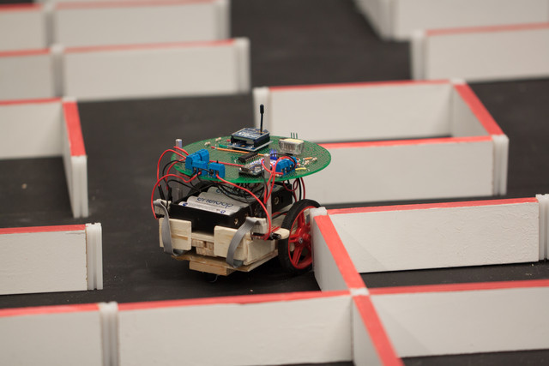

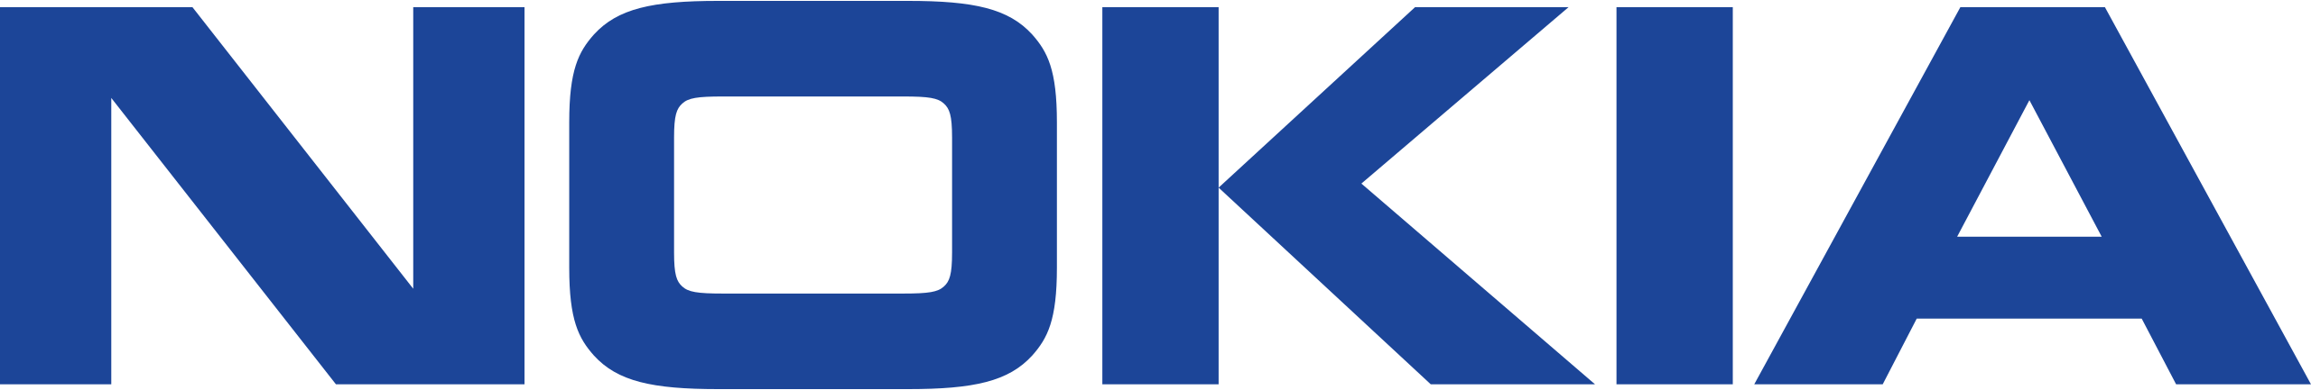
ROS Mapping Platform
A Middleware path for ROS-NonROS map​

Slide 2
Contributors
Students
Mentors
Aditya Pradhan
180905350
aditya.pradhan@learner.manipal.edu
Arihant Jha
180907582
arihant.jha1@learner.manipal.edu
Manickam Elangovan
Domain Leader, Nokia Bell Labs
elangovan.manickam@nokia-bell-labs.com
Shilpa Puttegowda Pais
5G System Specification Engineer, Nokia Networks
shilpa.puttegowda_pais@nokia.com
Poornalatha G
Associate Professor - Senior Scale, I&CT, MIT
poornalatha.g@manipal.edu

Slide 3
MIDDLEWARE
The Middleware platform will enable to map the ROS sensor data to non-ROS sensor data of the robotic system. This process enables experimenting with different environments and building exploration algorithms.
Aim of the Project
API
An API was used to connect to the Rosbridge tand get information about its various topics as well as send it information and control it remotely

Slide 4
ROS
Unity
Technologies used
Rviz
Gazebo
Major tools used
Rosbridge
RosLib.js

Slide 5
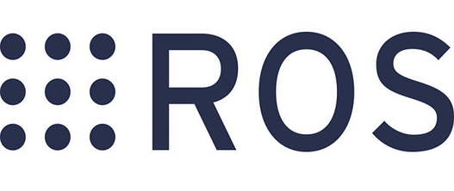
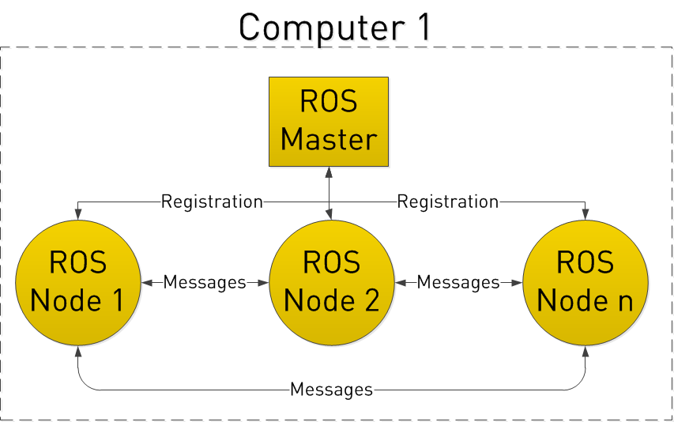
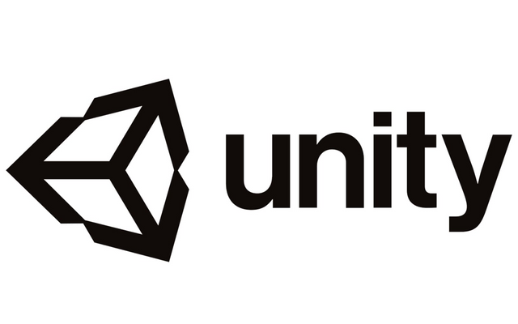
Brief Overview of Technology Used
ROS
Robot Operating System (ROS) is an open-source robotics middleware suite. It is a collection of software frameworks for robot software development.
Unity
Unity is cross-platform game engine. The engine can be used to create three-dimensional (3D) and two-dimensional (2D) games, as well as interactive simulations and other experiences

Slide 6
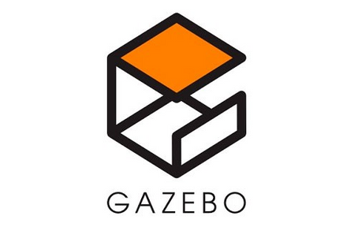
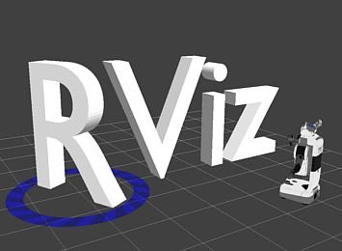
Brief Overview of Technology Used
Gazebo
Gazebo offers the ability to accurately and efficiently simulate populations of robots in complex indoor and outdoor environments.
Rviz
rviz is a powerful robot visualization tool. It provides a convenient GUI to visualize sensor data, robot models, environment maps, which is useful for developing and debugging your robot controllers.

Slide 7
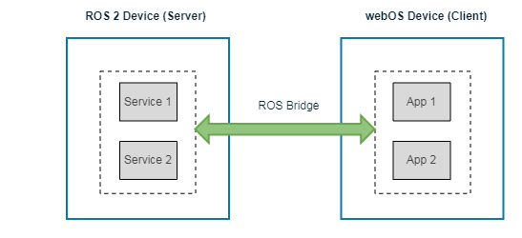
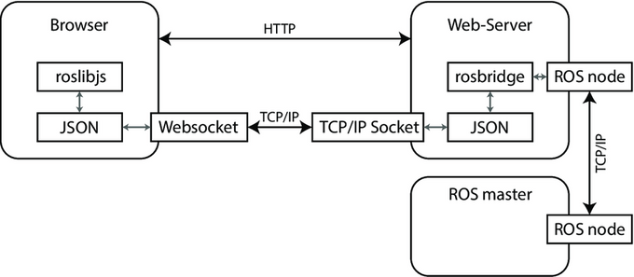
Brief Overview of Technology Used
Rosbridge
Rosbridge provides a JSON API to ROS functionality for non-ROS programs. There are a variety of front ends that interface with rosbridge, including a WebSocket server for web browsers to interact with.packages
Roslib.js
roslibjs is the core JavaScript library for interacting with ROS from the browser. It uses WebSockets to connect with rosbridge and provides publishing, subscribing, service calls, actionlib, TF, URDF parsing, and other essential ROS functionality.

Slide 8
Connecting Unity with Rosbridge
Siemens ROS Sharp
ROS TCP Connector
ROS Sharp was a generalized method to connect ROS with any UWP application and others as well. It communicated with ROS over ROS Bridge. It could send and receive data to ROS, import URDF models from the environment and send camera as well as sensor data.
ROS TCP Connector was a more specialized version of ROS Sharp made by Unity Technologies for the specific purpose of connecting ROS to Unity over ROS Bridge and sending and receiving data.

Slide 9
Visualizing Methods
LIDAR
vSLAM
LIDAR, which stands for Light Detection and Ranging, is a remote sensing method that uses light in the form of a pulsed laser to measure ranges by targeting an object with a laser and measuring the time for the reflected light to return to the receiver.
Visual simultaneous localization and mapping (vSLAM).
It refers to the process of determining the position and orientation of a sensor with respect to its surroundings, while simultaneously mapping the environment around that sensor.

Slide 10
GMapping
URDF Convertor
This package contains GMapping, from OpenSlam, and a ROS wrapper. The gmapping package provides laser-based SLAM. You can create a 2-D occupancy grid map (like a building floorplan) from laser and pose data collected by a mobile robot.
The Unified Robotic Description Format (URDF) is an XML file format used in ROS to describe all elements of a robot.
To use it in Unity we need to convert it into an appropriate format before we allowed to use it.

Slide 11
RMF
Robotics Middleware Framework stands for a collection of reusable, scalable libraries and tools building on top of ROS that enable the interoperability of heterogeneous fleets of any type of robotic systems. RMF utilizes standardized communication protocols to infrastructure, environments and automation where robots are deployed to optimize the use of critical resources (i.e. robots, lifts, doors, passageways, etc).
It enables interoperability among heterogeneous robot fleets while managing robot traffic that share resources such as space, building infrastructure systems (lifts, doors, etc) and other automation systems within the same facility. RMF also handles task allocation and conflict resolution among its participants (de-conflicting traffic lanes and other resources).”
The architecture of RMF is designed in such a way to allow scalability as the level of automation in an environment increases. There are various ways for systems and users to interact with RMF via APIs and customizable user interfaces. Once deployed in an environment, RMF will save costs by allowing resources to be shared and integrations to be minimized.

Slide 12
ROS Robots Limitations
Difficulty in learning: ROS can be difficult to learn. It has a steep learning curve and developers should become familiar with many new concepts to get benefits from the ROS framework.
Difficulties in starting with simulation: The main simulator in ROS is Gazebo. Even though Gazebo works well, to get started with Gazebo is not an easy task. The simulator has no inbuilt features to program. Complete simulation is done only through coding in ROS. When we compare Gazebo with other simulators, such as V-REP and Webots, they have inbuilt functionalities to prototype and program the robot.
Difficulties in robot modeling: The robot modeling in ROS is performed using URDF, which is an XML-based robot description. In short, we need to write the robot model as a description using URDF tags
Potential limitations:Current ROS versions have some limitations. For example, there is a lack of a native real-time application development support or the complexity to implement robust multi-robot distributed applications.
Different for different robots: When we deploy ROS on a commercial product, a lot of things need to be taken care of. One thing is the code quality. Most of the code in ROS is contributed by researchers from universities, so if we are not satisfied with the ROS code quality, it is better to write our own code, which is specific to the robot and only use the ROS core functionalities if required.

Slide 13
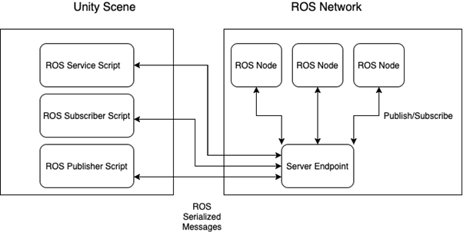
Approaching the problem

Slide 14

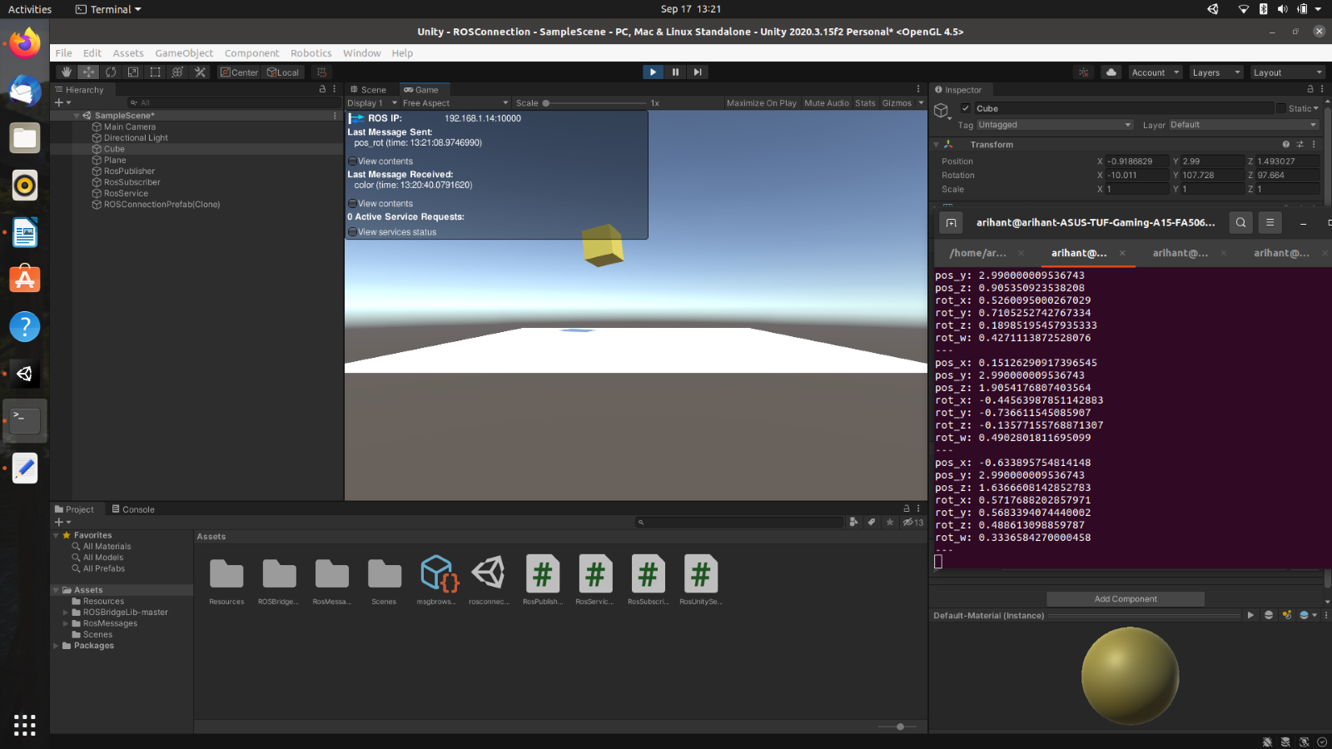

Slide 15
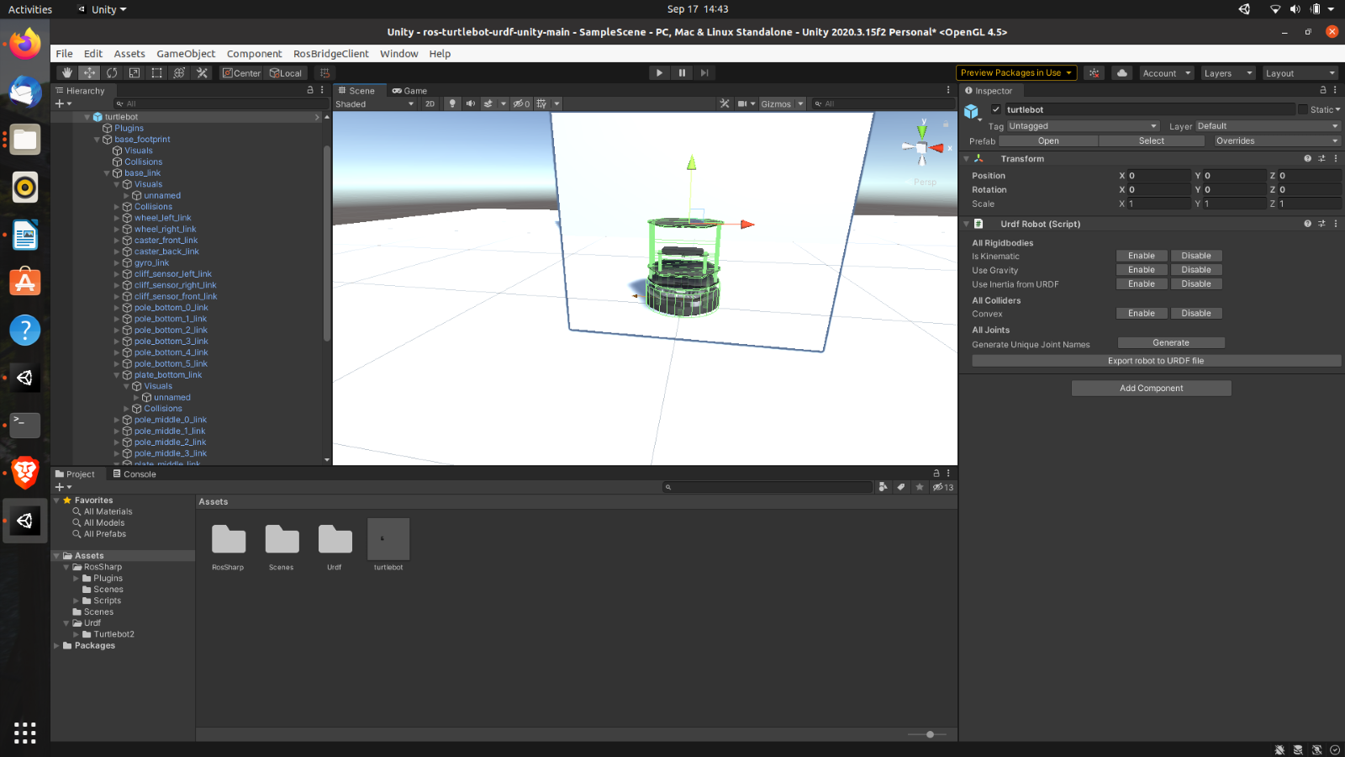

Slide 16
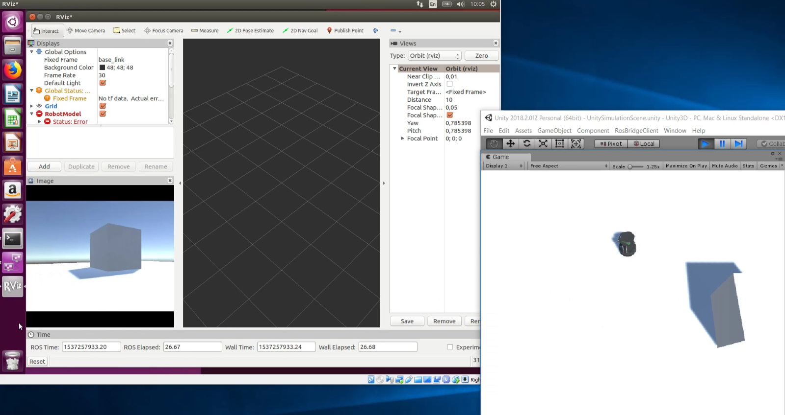

Slide 17
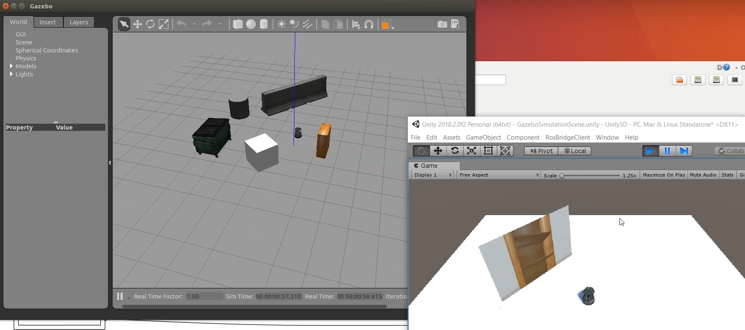

Slide 18
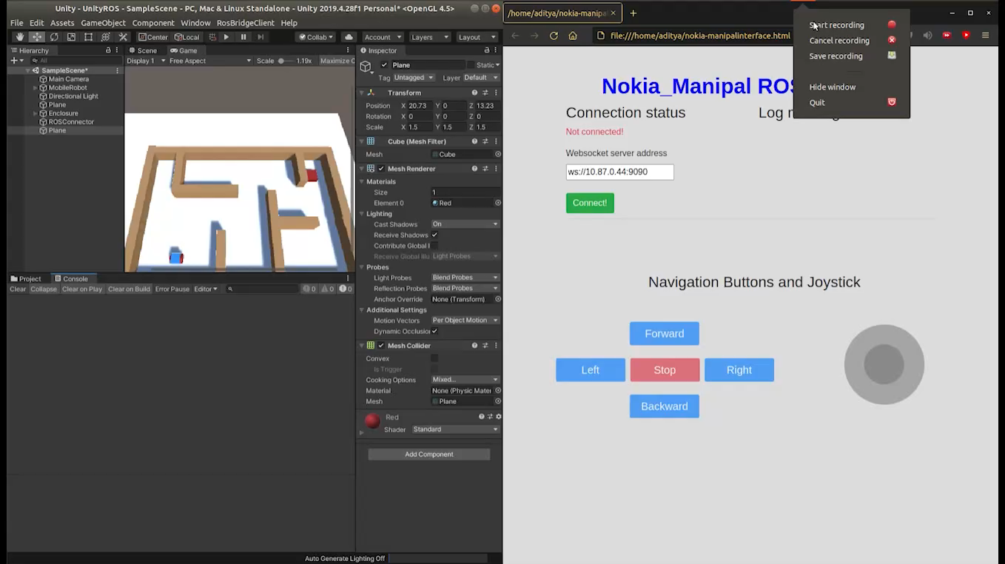
ROSBRIDGE WEB API

Slide 19
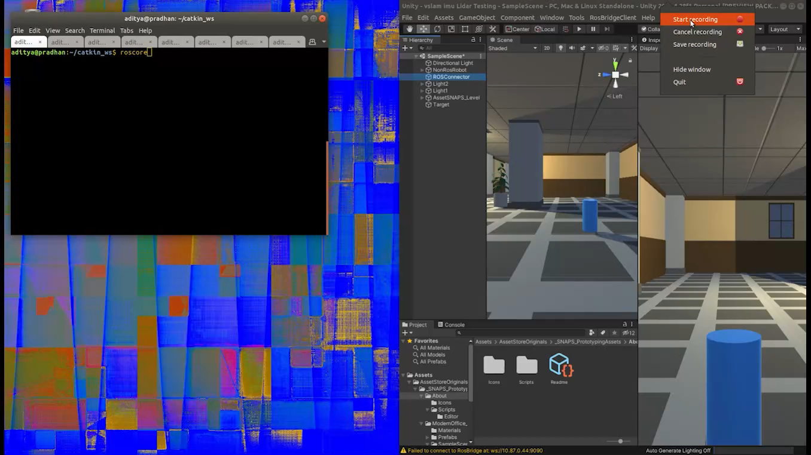
UNITY ROS NavMesh

Slide 20
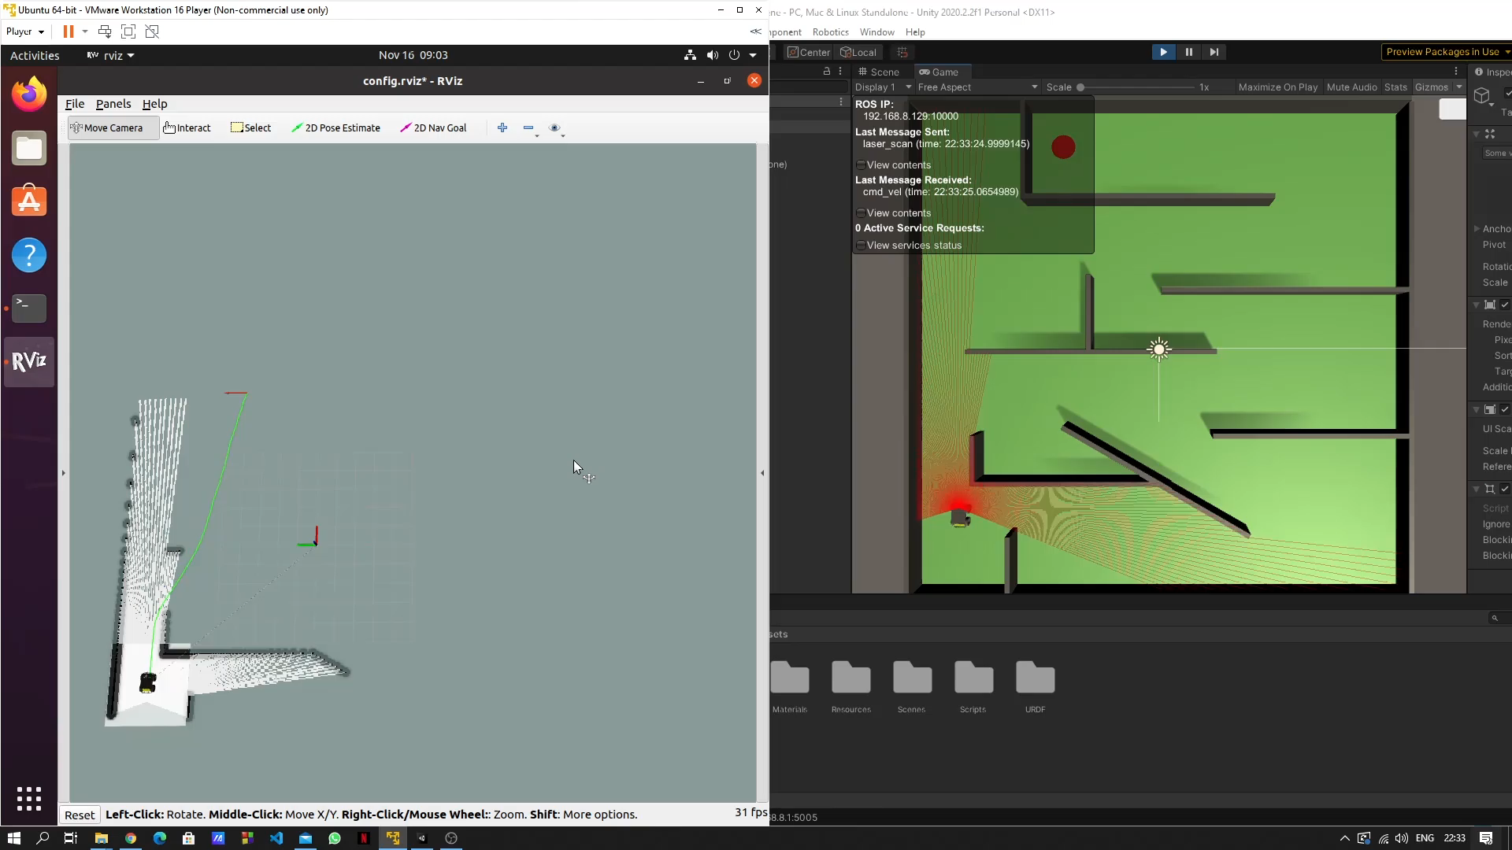
SLAM with Unity

Slide 21
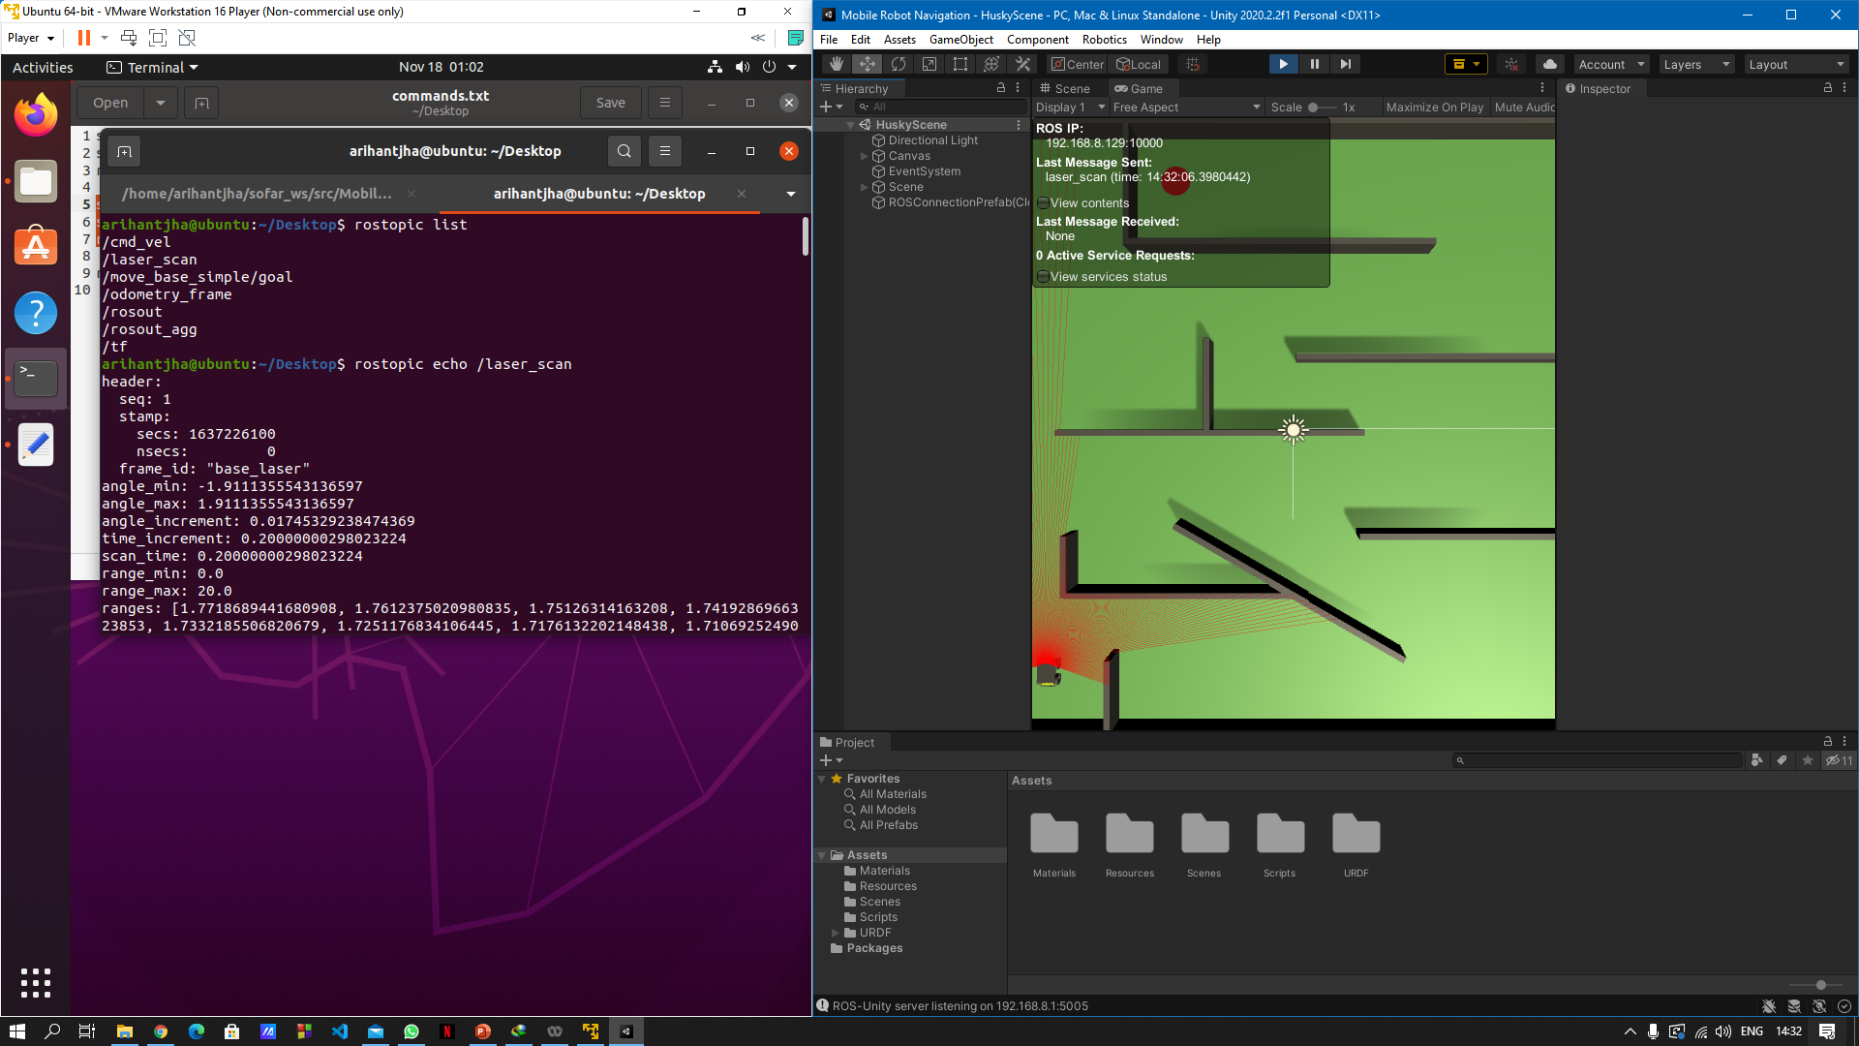

Slide 22
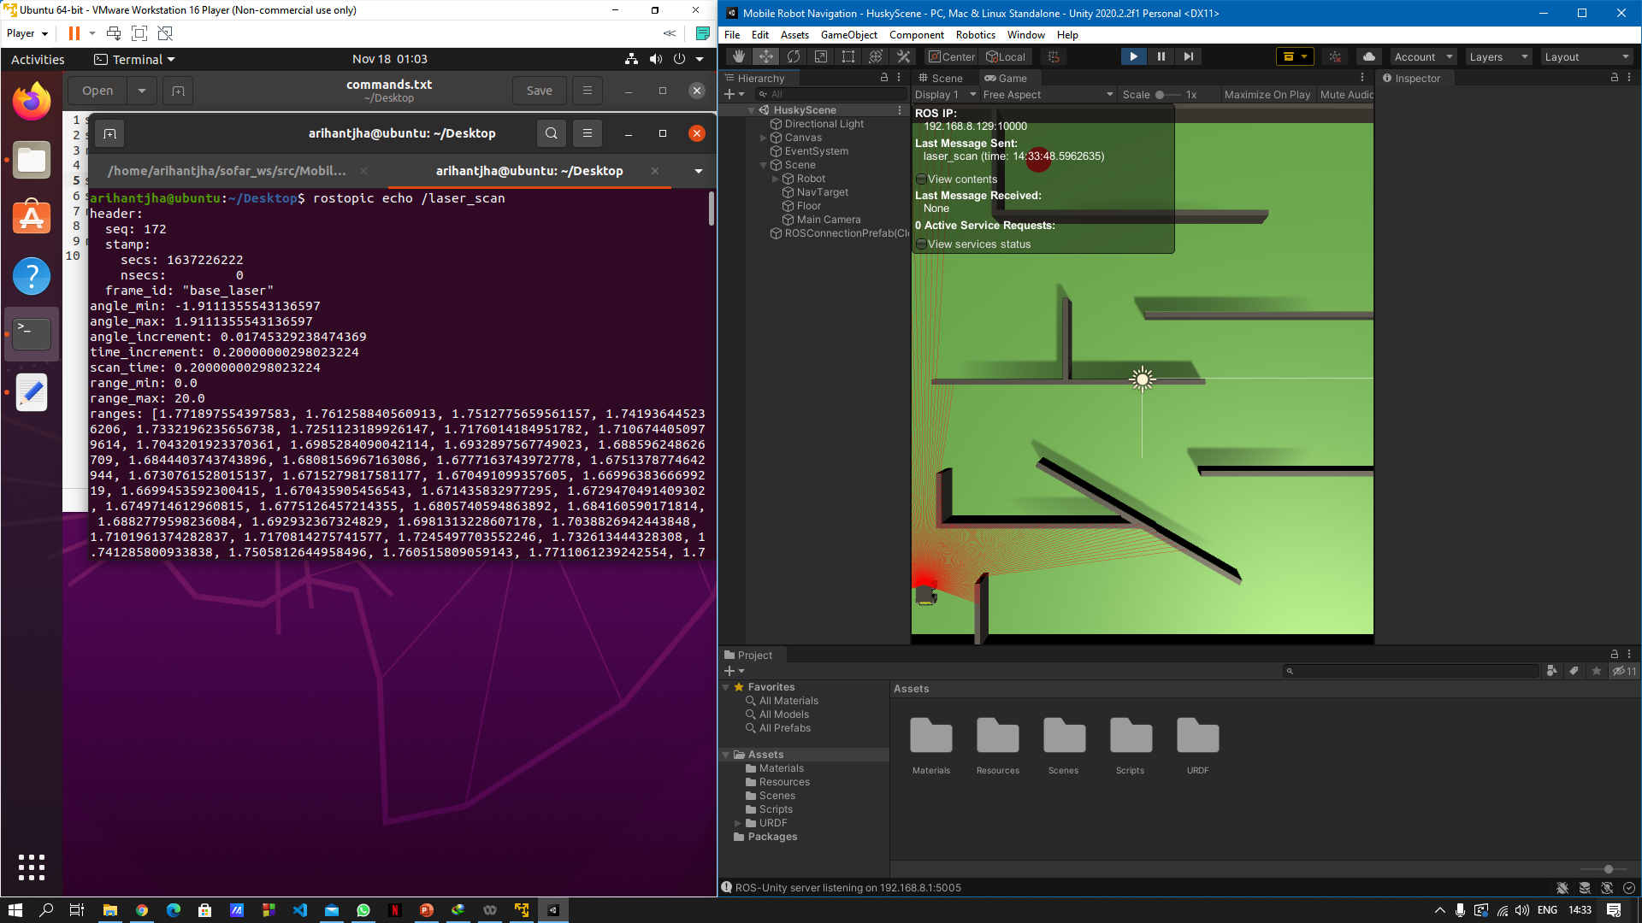

Slide 23
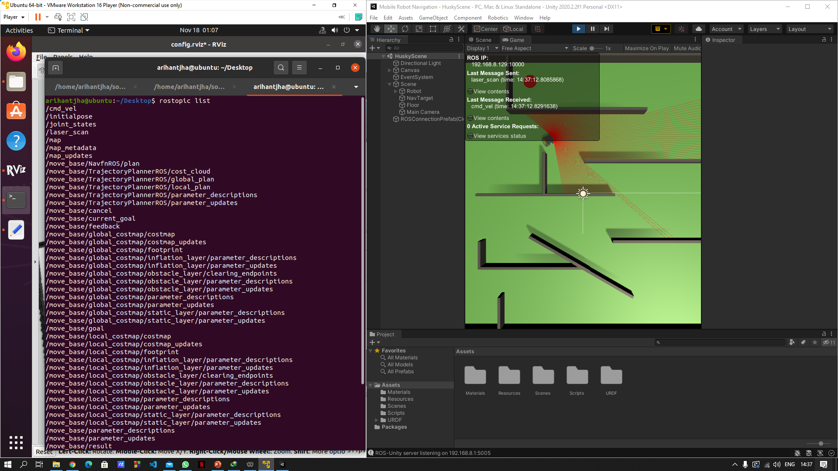

Slide 24
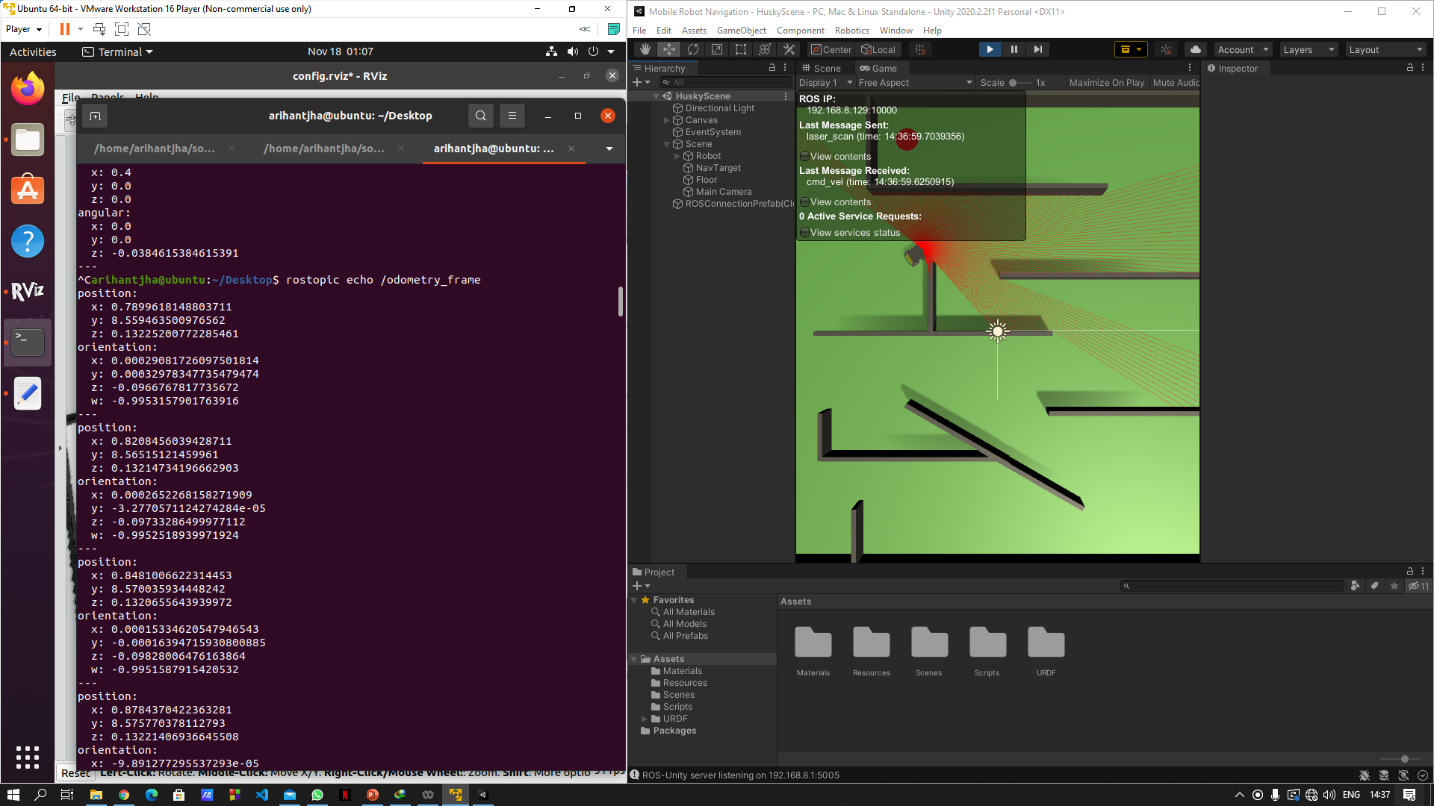

Slide 25
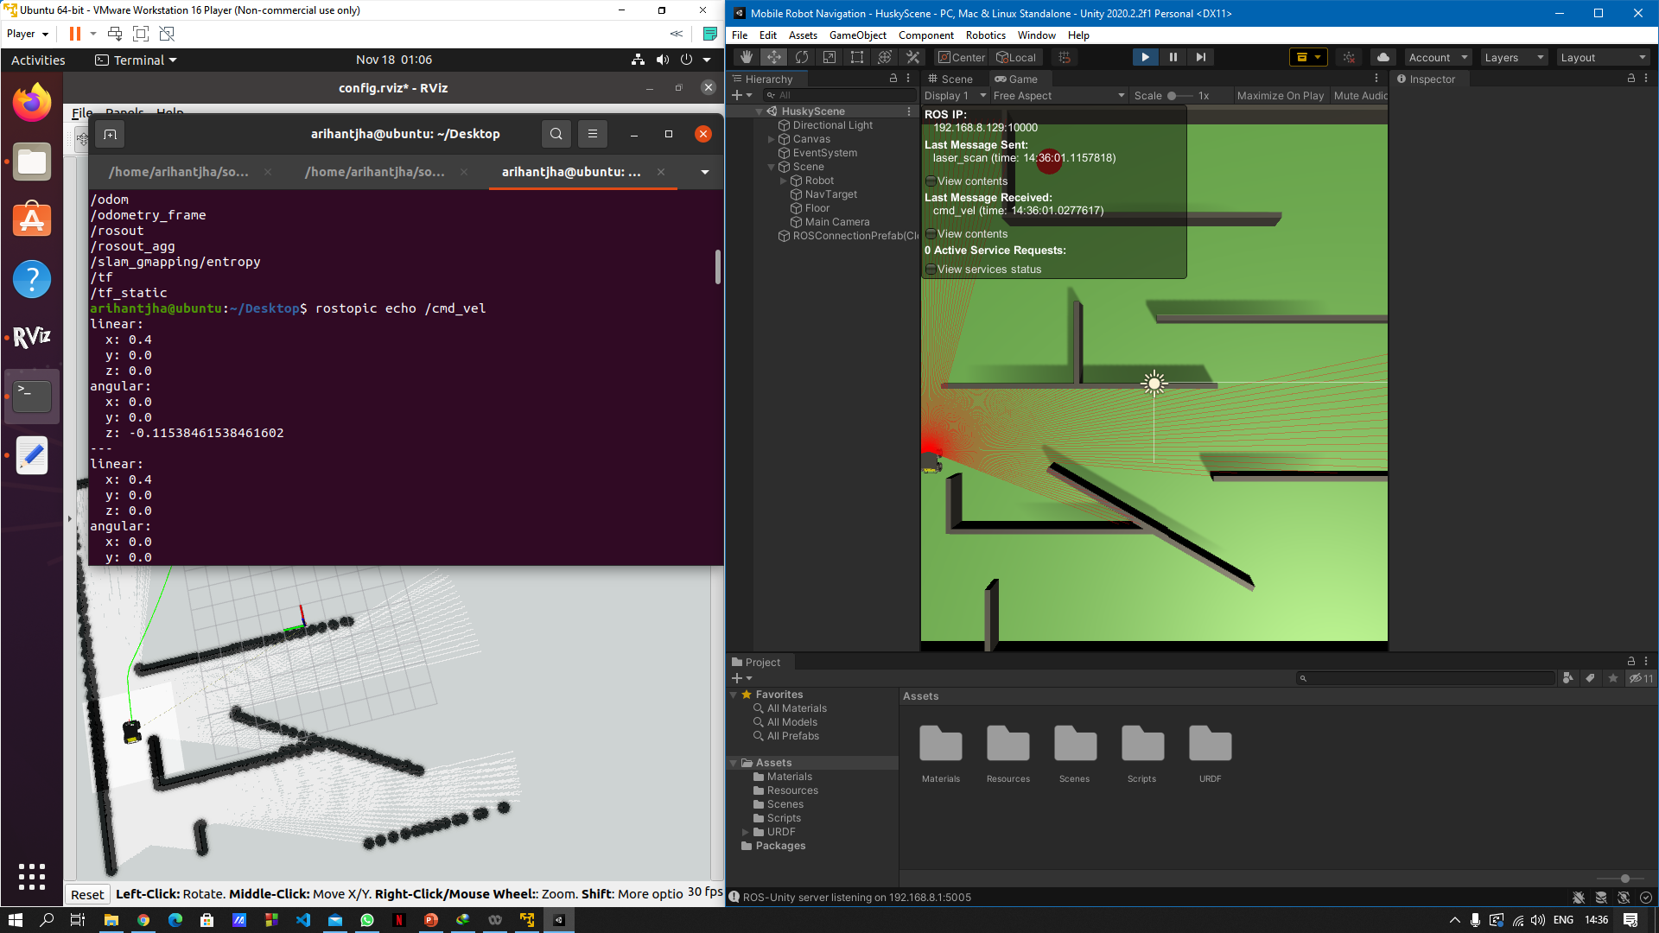

Slide 27
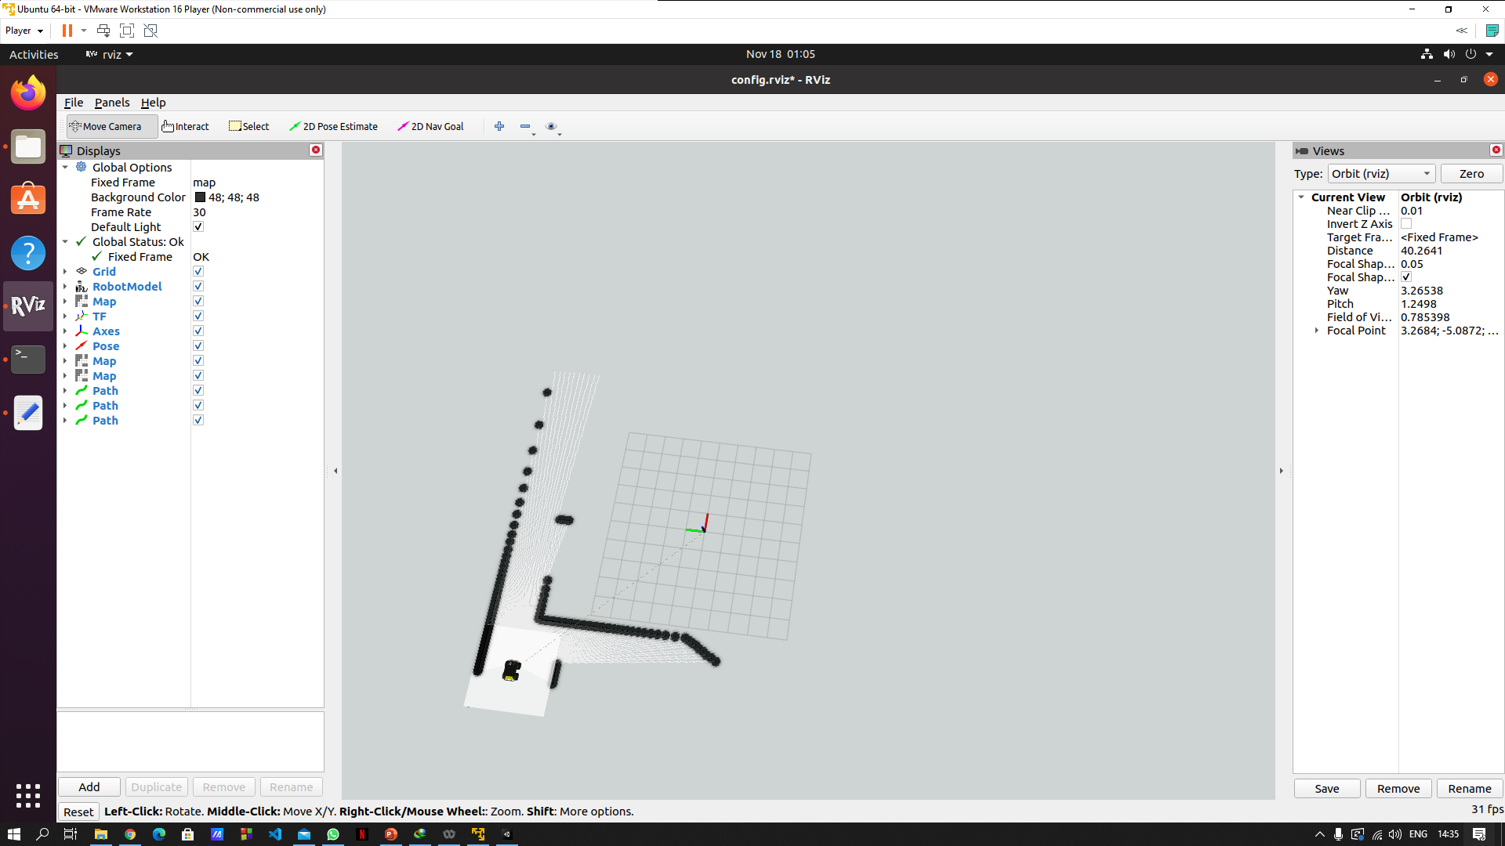

Slide 28
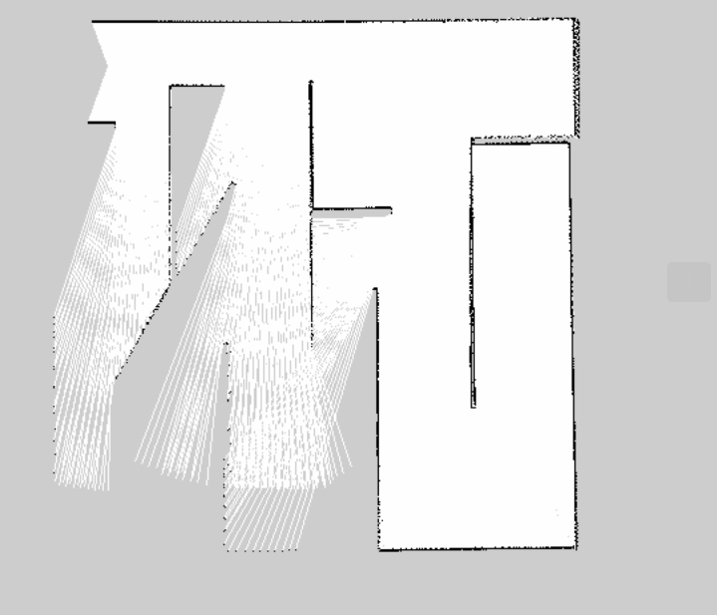
Map built by SLAM

Slide 29
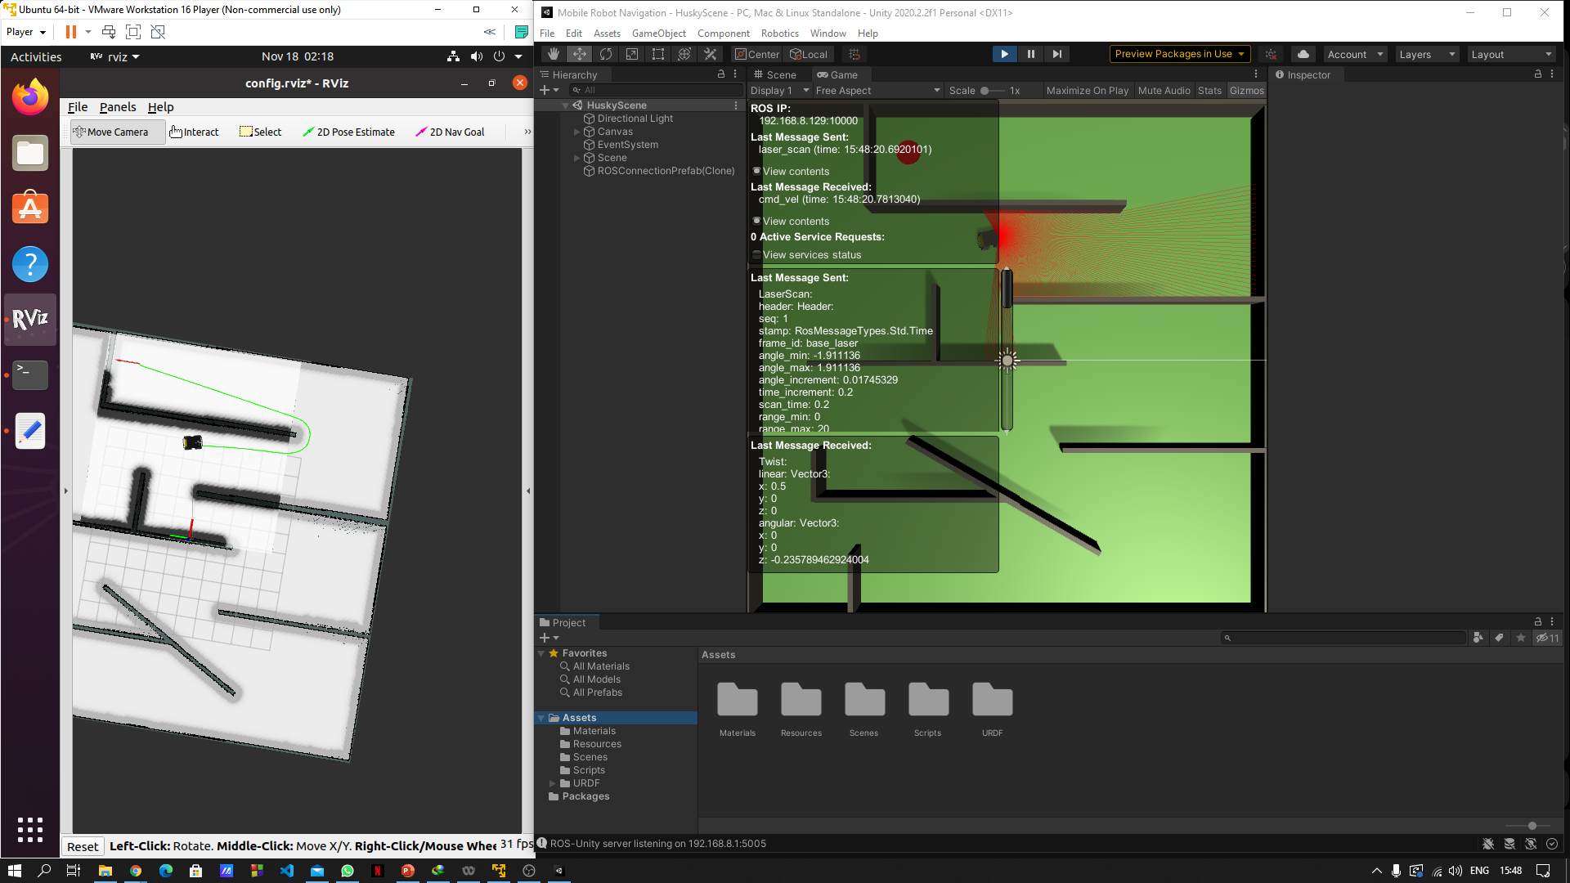

Slide 30
Applications of Middleware
ROS is an opens source software built for all robotics need with state of the art algorithms which take very little time to deploy and are robust.
Third party vendor robots or robots that do not natively support ROS cannot benefit from the huge library of algorithms ROS contains.
Algorithms such as SLAM, frontier exploration and fleet management are some of the popular packages people used in ROS frequently.
With this project we will be able to bring all this functionalities to any robot existing.
Real life instance – Chennai factory OMRON robots can use SLAM to build large maps automatically and can dynamically update according to changes made in the factory.
We can also deploy fleet management to control all the robots

Slide 31
Thank
you!

